Slide 1
Data Structures
18. Minimum Spanning Trees

Slide 2
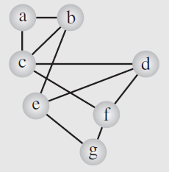
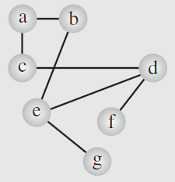
Spanning trees
Consider the graph representing the airline connections between seven cities
If the economic situation forces this airline to shut down as many connections as possible, which of them should be retained to make sure that it is still possible to reach any city from any other city, if only indirectly?
City a can be reached from city d using the path d, c, a, but it is also possible to use the path d, e, b, a
One possibility

Slide 3
Spanning trees
Because the number of retained connections is the issue, there is still the possibility we can reduce this number
It should be clear that the minimum number of such connections form a tree because alternate paths arise as a result of cycles in the graph
Hence, to create the minimum number of connections, a spanning tree should be created, and such a spanning tree is the by product
of depth-first search
One possibility

Slide 4
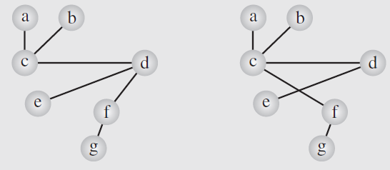
Spanning trees
Clearly, we can create different spanning trees—that is, we can decide to retain different sets of connections—but
all these trees have six edges and we cannot do any better than that
One possibility

Slide 5
Minimum spanning trees
The solution to this problem is not optimal in that the distances between cities have not been taken into account
Because there are alternative six-edge connections between cities, the airline uses the cost of these connections to choose the best, guaranteeing the optimum cost
This can be achieved by having shortest distances for the six connections
This problem can now be phrased as finding a minimum spanning tree, which is a spanning tree in which the sum of the weights of its edges is minimal

Slide 6
Minimum spanning trees
Given a connected graph with |V| = n vertices, a spanning tree is,
a collection of n - 1 edges connecting all n vertices
A spanning tree is not necessarily unique
Weight of a spanning tree is the sum of the weights on all the edges in the spanning tree
Minimum spanning trees is a tree which minimizes this weight

Slide 7
Minimum spanning trees
Applications
Lay down the circuit elements on a board
Determine location of loading docks within a building
Find best means to connect multiple LANs
Determine manageable clusters of terminals within an ad hoc network
…

Slide 8
Minimum spanning trees
Many solutions exist to this minimum spanning tree problem
Two famous algorithms
Prim’s algorithm
Kruskal’s algorithm

Slide 9
Prim’s Algorithm: overview
Input
An undirected weighted graph
Basic idea
Select unvisited vertex with minimum distance
Mark it as visited for each adjacent vertex, if the weight of the connecting edge is less than its current distance
Update distance of the adjacent vertex
Set current vertex as parent of the adjacent vertex
Halting point
No unvisited vertices with distance < ∞
Note: distance = ∞ means the graph is disconnected
Output
A forest of minimum spanning tree on all connected sub-graphs

Slide 10
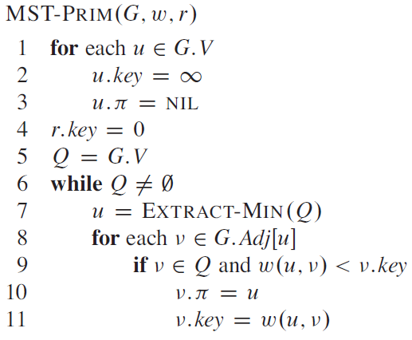
Prim’s Algorithm: pseudocode

Slide 11
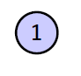
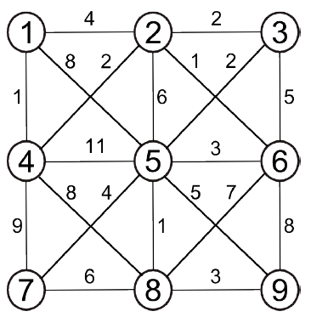
Prim’s Algorithm: overview
Initialize the table
select root vertex, set distance to 0
visited to false
parent to 0
Vertex | Visited | Distance | Parent
1 | F | 0 | 0
2 | F | ∞ | 0
3 | F | ∞ | 0
4 | F | ∞ | 0
5 | F | ∞ | 0
6 | F | ∞ | 0
7 | F | ∞ | 0
8 | F | ∞ | 0
9 | F | ∞ | 0

Slide 12
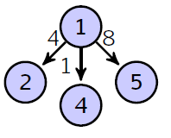
Prim’s Algorithm: overview
Visit vertex 1
update 2, 4 and 5
extend trivial tree
select vertex with minimum weight
Vertex | Visited | Distance | Parent
1 | T | 0 | 0
2 | F | 4 | 1
3 | F | ∞ | 0
4 | F | 1 | 1
5 | F | 8 | 1
6 | F | ∞ | 0
7 | F | ∞ | 0
8 | F | ∞ | 0
9 | F | ∞ | 0

Slide 13
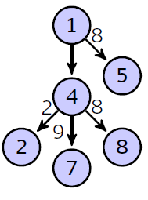
Prim’s Algorithm: overview
Visit vertex 4
update 2, 7 and 8, except 5
extend the tree
select vertex with minimum weight
Vertex | Visited | Distance | Parent
1 | T | 0 | 0
2 | F | 2 | 4
3 | F | ∞ | 0
4 | T | 1 | 1
5 | F | 8 | 1
6 | F | ∞ | 0
7 | F | 9 | 4
8 | F | 8 | 4
9 | F | ∞ | 0

Slide 14
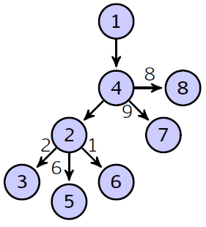
Prim’s Algorithm: overview
Visit vertex 2
update 3, 5 and 6
extend the tree
select vertex with minimum weight
Vertex | Visited | Distance | Parent
1 | T | 0 | 0
2 | T | 2 | 4
3 | F | 2 | 2
4 | T | 1 | 1
5 | F | 6 | 2
6 | F | 1 | 2
7 | F | 9 | 4
8 | F | 8 | 4
9 | F | ∞ | 0

Slide 15
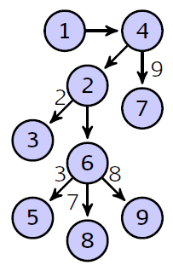
Prim’s Algorithm: overview
Visit vertex 6
update 5, 8 and 9, except 3
extend the tree
select vertex with minimum weight
Vertex | Visited | Distance | Parent
1 | T | 0 | 0
2 | T | 2 | 4
3 | F | 2 | 2
4 | T | 1 | 1
5 | F | 3 | 6
6 | T | 1 | 2
7 | F | 9 | 4
8 | F | 7 | 6
9 | F | 8 | 6

Slide 16
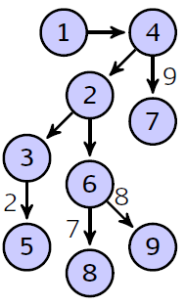
Prim’s Algorithm: overview
Visit vertex 3
update 5 only
extend the tree
select vertex with minimum weight
Vertex | Visited | Distance | Parent
1 | T | 0 | 0
2 | T | 2 | 4
3 | T | 2 | 2
4 | T | 1 | 1
5 | F | 2 | 3
6 | T | 1 | 2
7 | F | 9 | 4
8 | F | 7 | 6
9 | F | 8 | 6

Slide 17
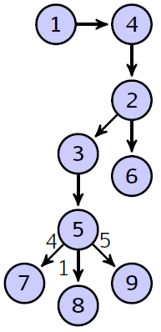
Prim’s Algorithm: overview
Visit vertex 5
update 7, 8 and 9
extend the tree
select vertex with minimum weight
Vertex | Visited | Distance | Parent
1 | T | 0 | 0
2 | T | 2 | 4
3 | T | 2 | 2
4 | T | 1 | 1
5 | T | 2 | 3
6 | T | 1 | 2
7 | F | 4 | 5
8 | F | 1 | 5
9 | F | 5 | 5

Slide 18
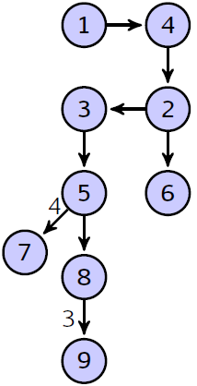
Prim’s Algorithm: overview
Visit vertex 8
update 9 only
extend the tree
select vertex with minimum weight
Vertex | Visited | Distance | Parent
1 | T | 0 | 0
2 | T | 2 | 4
3 | T | 2 | 2
4 | T | 1 | 1
5 | T | 2 | 3
6 | T | 1 | 2
7 | F | 4 | 5
8 | T | 1 | 5
9 | F | 3 | 8

Slide 19
Prim’s Algorithm: overview
Visit vertex 9
no updates
no change to the tree
select vertex with minimum weight
Vertex | Visited | Distance | Parent
1 | T | 0 | 0
2 | T | 2 | 4
3 | T | 2 | 2
4 | T | 1 | 1
5 | T | 2 | 3
6 | T | 1 | 2
7 | F | 4 | 5
8 | T | 1 | 5
9 | T | 3 | 8

Slide 20
Prim’s Algorithm: overview
Visit vertex 7
no updates
no change to the tree
halt, as all vertices are visited
Vertex | Visited | Distance | Parent
1 | T | 0 | 0
2 | T | 2 | 4
3 | T | 2 | 2
4 | T | 1 | 1
5 | T | 2 | 3
6 | T | 1 | 2
7 | T | 4 | 5
8 | T | 1 | 5
9 | T | 3 | 8

Slide 22
Kruskal’s algorithm
This topic covers Kruskal’s algorithm:
Finding a minimum spanning tree
The idea and the algorithm
An example
Using a disjoint set data structure

Slide 23
Kruskal’s Algorithm
Kruskal’s algorithm sorts the edges by weight and goes through the edges from least weight to greatest weight adding the edges to an empty graph so long as the addition does not create a cycle
The halting point is:
When |V| – 1 edges have been added
In this case we have a minimum spanning tree
We have gone through all edges, in which case, we have a forest of minimum spanning trees on all connected sub-graphs

Slide 24
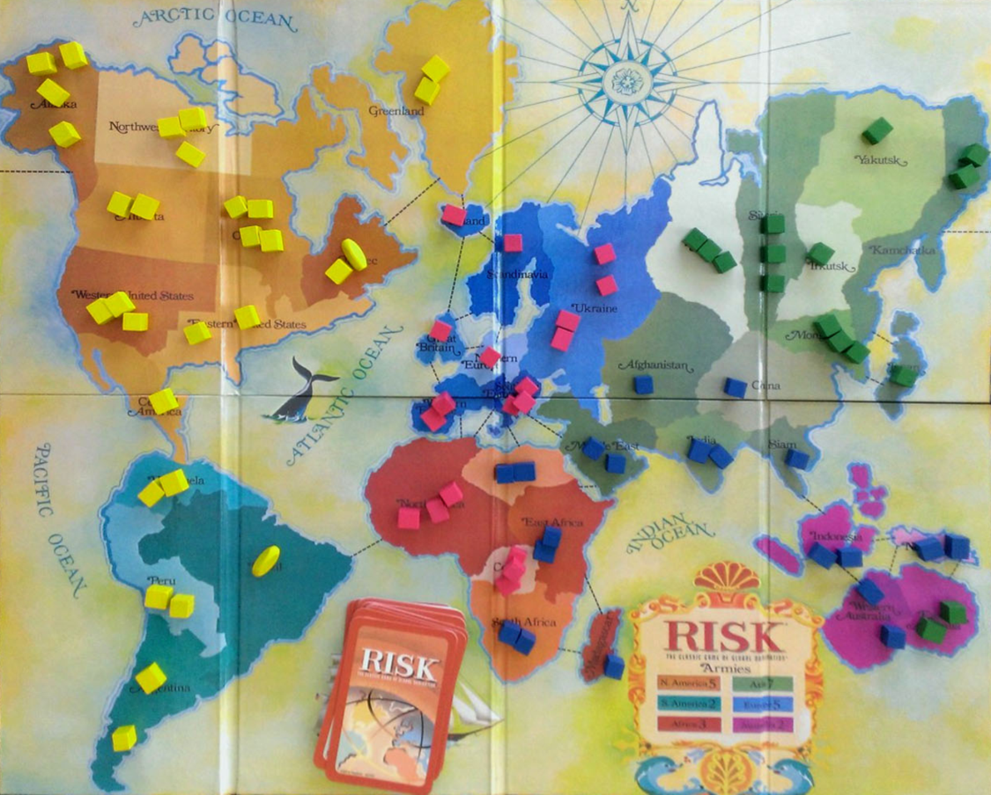
Example
Consider the game of Risk from Parker Brothers
A game of world domination
The world is divided into 42 connected regions
http://thunderbird37.com/tag/parker-brothers/

Slide 25
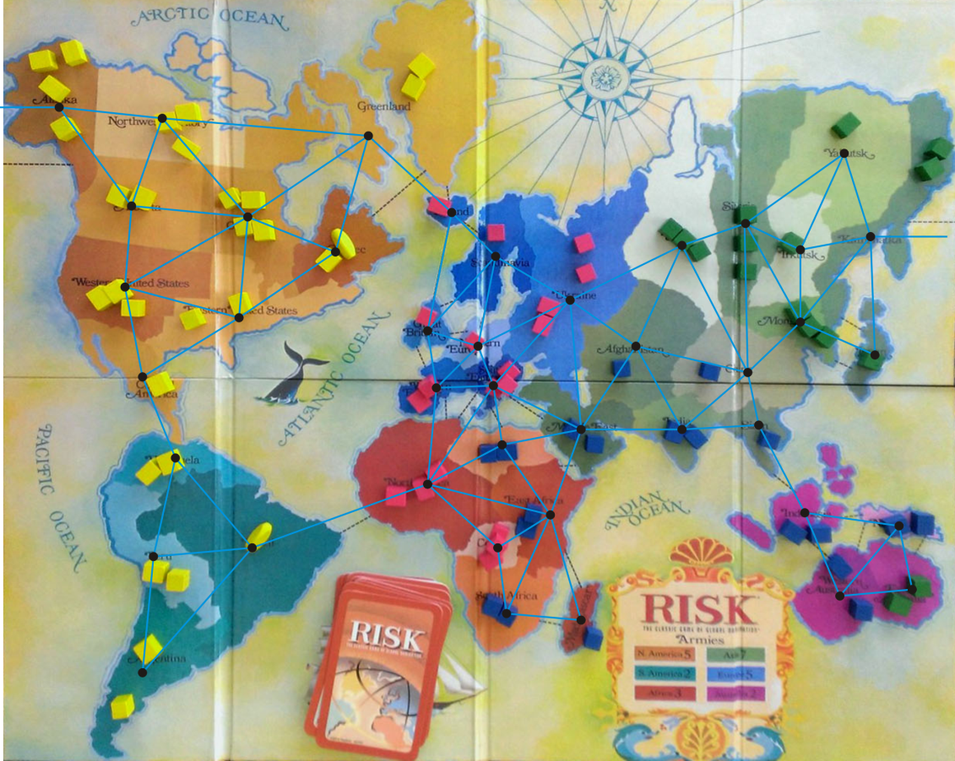
Example
Consider the game of Risk from Parker Brothers
A game of world domination
The world is divided into 42 connected regions
The regions are vertices and edges indicate adjacent regions
http://thunderbird37.com/tag/parker-brothers/

Slide 26
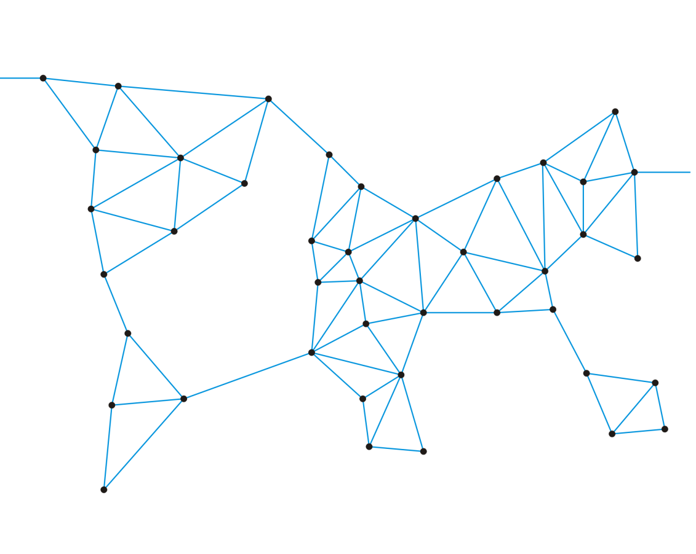
Example
Consider the game of Risk from Parker Brothers
A game of world domination
The world is divided into 42 connected regions
The regions are vertices and edges indicate adjacent regions
The graph is sufficient to describe the game

Slide 27
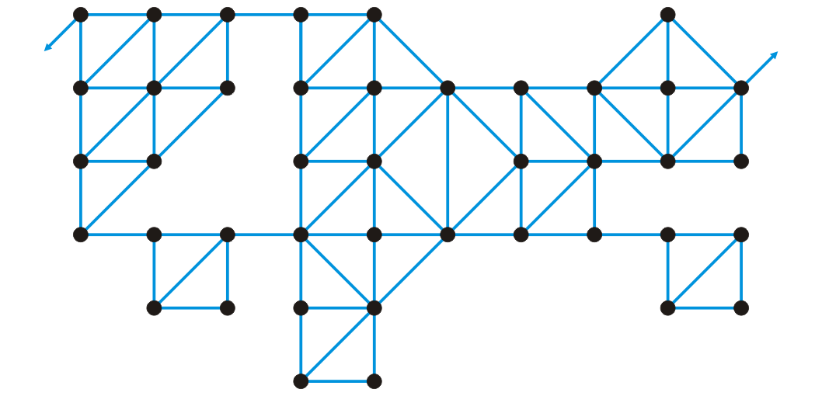
Example
Consider the game of Risk from Parker Brothers
Here is a more abstract representation of the game board
Suddenly, it’s less interesting: “I’ve conquered the graph!”

Slide 28
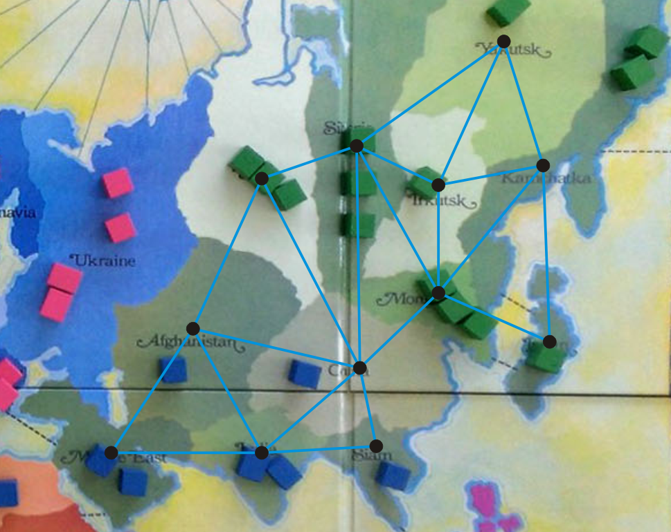
Example
We’ll focus on Asia
http://thunderbird37.com/tag/parker-brothers/

Slide 29
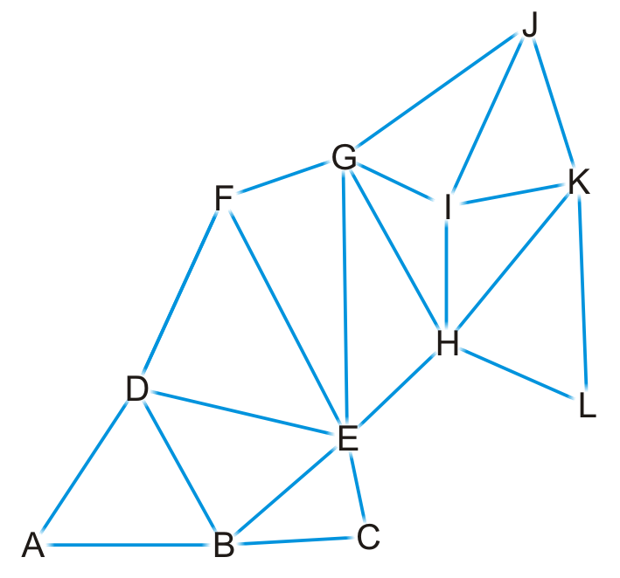
Example
Here is our abstract representation

Slide 30
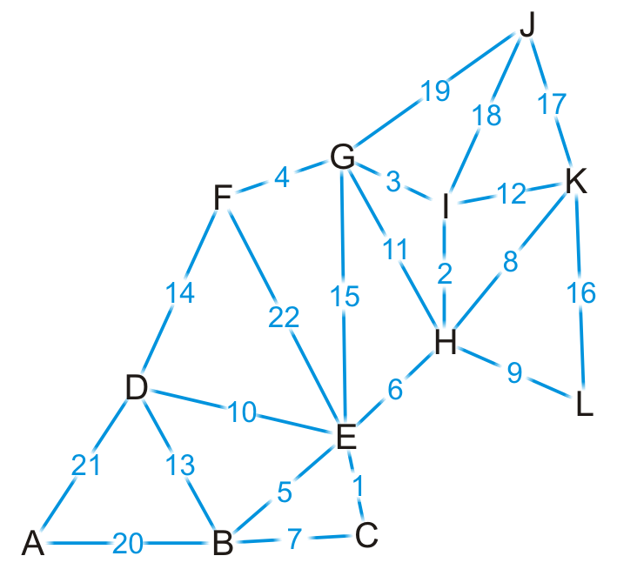
Example
Let us give a weight to each of the edges

Slide 31
Example
{C, E}
{H, I}
{G, I}
{F, G}
{B, E}
{E, H}
{B, C}
{H, K}
{H, L}
{D, E}
{G, H}
{I, K}
{B, D}
{D, F}
{E, G}
{K, L}
{J, K}
{J, I}
{J, G}
{A, B}
{A, D}
{E, F}
First, we sort the edges based on weight

Slide 32

Example
{C, E}
{H, I}
{G, I}
{F, G}
{B, E}
{E, H}
{B, C}
{H, K}
{H, L}
{D, E}
{G, H}
{I, K}
{B, D}
{D, F}
{E, G}
{K, L}
{J, K}
{J, I}
{J, G}
{A, B}
{A, D}
{E, F}
We start by adding edge {C, E}

Slide 33
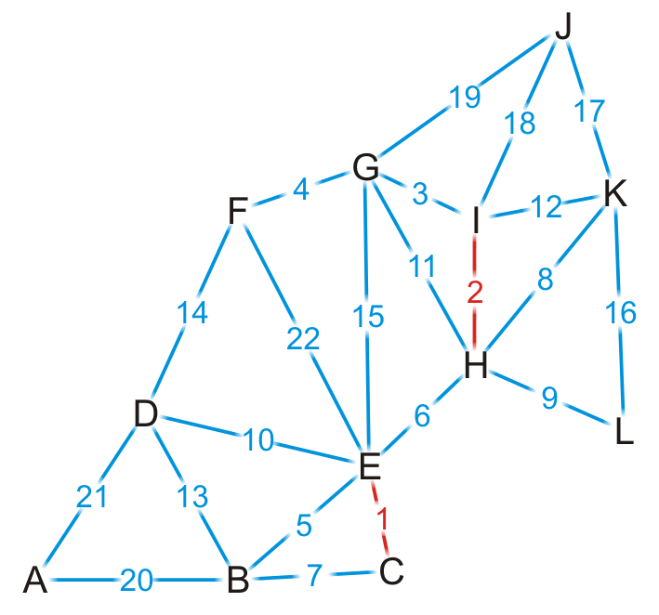
Example
{C, E}
{H, I}
{G, I}
{F, G}
{B, E}
{E, H}
{B, C}
{H, K}
{H, L}
{D, E}
{G, H}
{I, K}
{B, D}
{D, F}
{E, G}
{K, L}
{J, K}
{J, I}
{J, G}
{A, B}
{A, D}
{E, F}
We add edge {H, I}

Slide 34
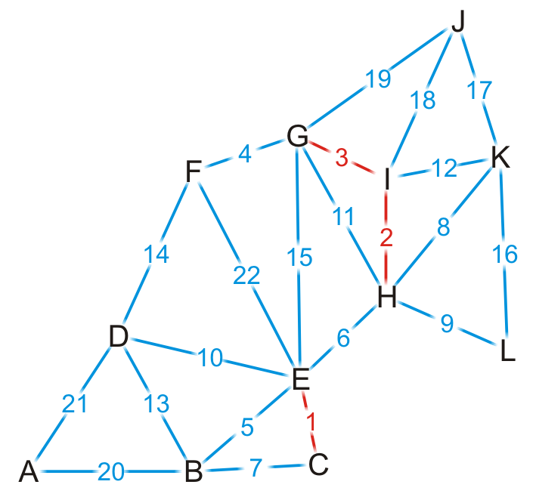
Example
{C, E}
{H, I}
{G, I}
{F, G}
{B, E}
{E, H}
{B, C}
{H, K}
{H, L}
{D, E}
{G, H}
{I, K}
{B, D}
{D, F}
{E, G}
{K, L}
{J, K}
{J, I}
{J, G}
{A, B}
{A, D}
{E, F}
We add edge {G, I}

Slide 35

Example
{C, E}
{H, I}
{G, I}
{F, G}
{B, E}
{E, H}
{B, C}
{H, K}
{H, L}
{D, E}
{G, H}
{I, K}
{B, D}
{D, F}
{E, G}
{K, L}
{J, K}
{J, I}
{J, G}
{A, B}
{A, D}
{E, F}
We add edge {F, G}

Slide 36
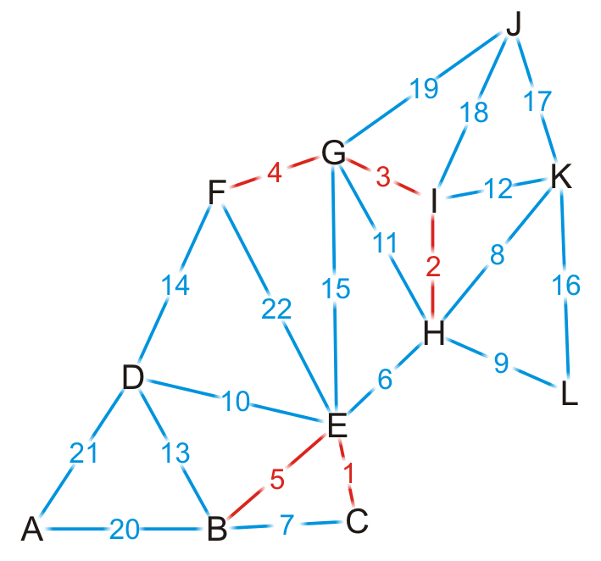
Example
{C, E}
{H, I}
{G, I}
{F, G}
{B, E}
{E, H}
{B, C}
{H, K}
{H, L}
{D, E}
{G, H}
{I, K}
{B, D}
{D, F}
{E, G}
{K, L}
{J, K}
{J, I}
{J, G}
{A, B}
{A, D}
{E, F}
We add edge {B, E}

Slide 37
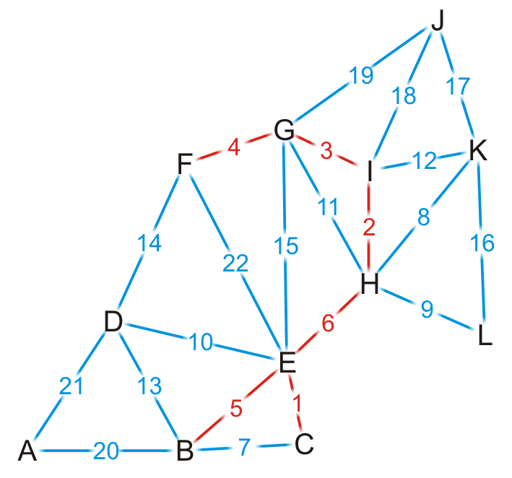
Example
{C, E}
{H, I}
{G, I}
{F, G}
{B, E}
{E, H}
{B, C}
{H, K}
{H, L}
{D, E}
{G, H}
{I, K}
{B, D}
{D, F}
{E, G}
{K, L}
{J, K}
{J, I}
{J, G}
{A, B}
{A, D}
{E, F}
We add edge {E, H}
This coalesces the two spanning sub-trees into one

Slide 38
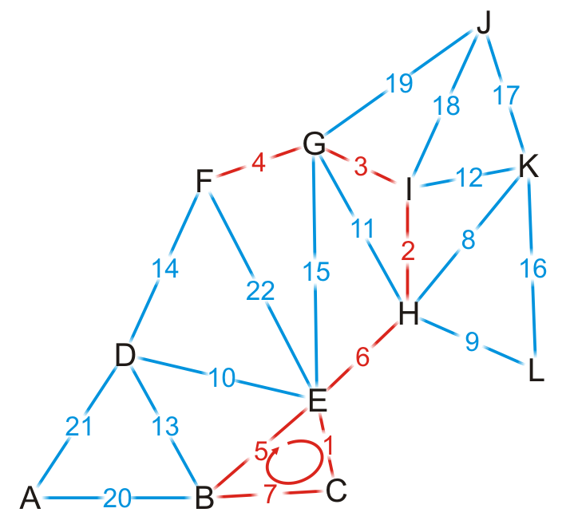
Example
{C, E}
{H, I}
{G, I}
{F, G}
{B, E}
{E, H}
{B, C}
{H, K}
{H, L}
{D, E}
{G, H}
{I, K}
{B, D}
{D, F}
{E, G}
{K, L}
{J, K}
{J, I}
{J, G}
{A, B}
{A, D}
{E, F}
We try adding {B, C}, but it creates a cycle

Slide 39
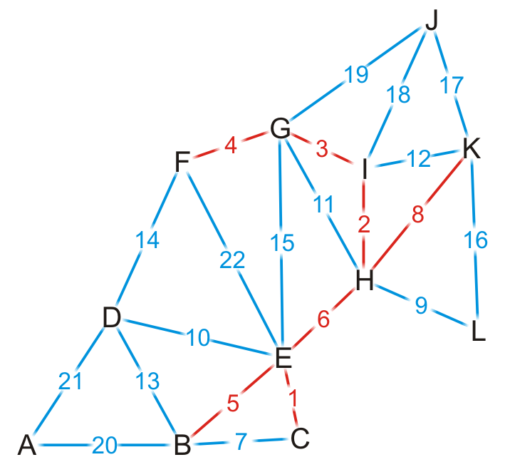
Example
{C, E}
{H, I}
{G, I}
{F, G}
{B, E}
{E, H}
{B, C}
{H, K}
{H, L}
{D, E}
{G, H}
{I, K}
{B, D}
{D, F}
{E, G}
{K, L}
{J, K}
{J, I}
{J, G}
{A, B}
{A, D}
{E, F}
We add edge {H, K}

Slide 40
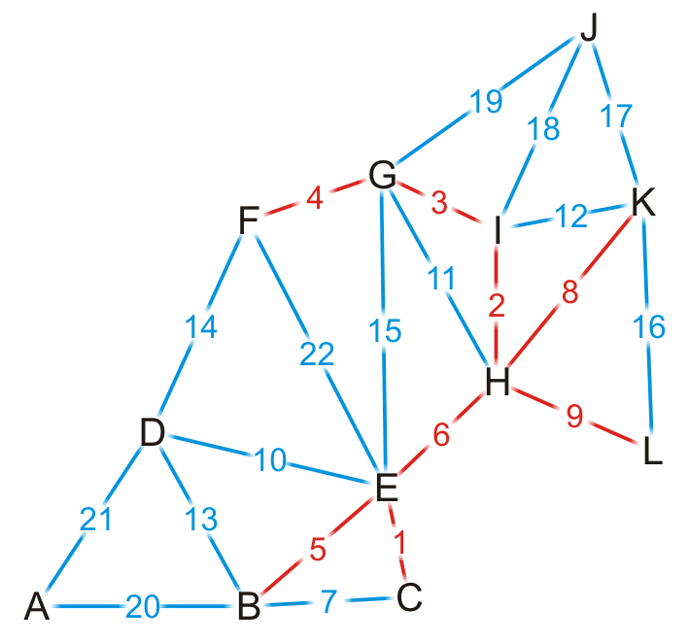
Example
{C, E}
{H, I}
{G, I}
{F, G}
{B, E}
{E, H}
{B, C}
{H, K}
{H, L}
{D, E}
{G, H}
{I, K}
{B, D}
{D, F}
{E, G}
{K, L}
{J, K}
{J, I}
{J, G}
{A, B}
{A, D}
{E, F}
We add edge {H, L}

Slide 41
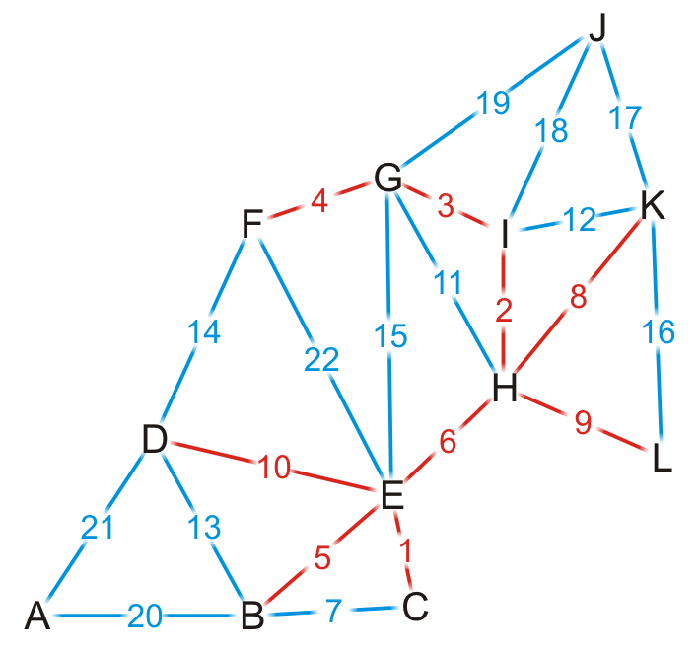
Example
{C, E}
{H, I}
{G, I}
{F, G}
{B, E}
{E, H}
{B, C}
{H, K}
{H, L}
{D, E}
{G, H}
{I, K}
{B, D}
{D, F}
{E, G}
{K, L}
{J, K}
{J, I}
{J, G}
{A, B}
{A, D}
{E, F}
We add edge {D, E}

Slide 42
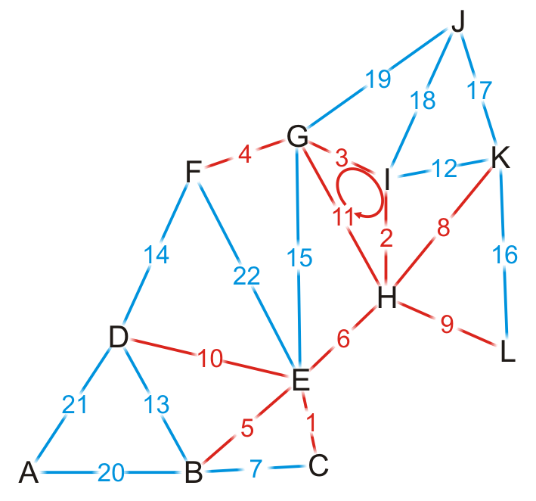
Example
{C, E}
{H, I}
{G, I}
{F, G}
{B, E}
{E, H}
{B, C}
{H, K}
{H, L}
{D, E}
{G, H}
{I, K}
{B, D}
{D, F}
{E, G}
{K, L}
{J, K}
{J, I}
{J, G}
{A, B}
{A, D}
{E, F}
We try adding {G, H}, but it creates a cycle

Slide 43
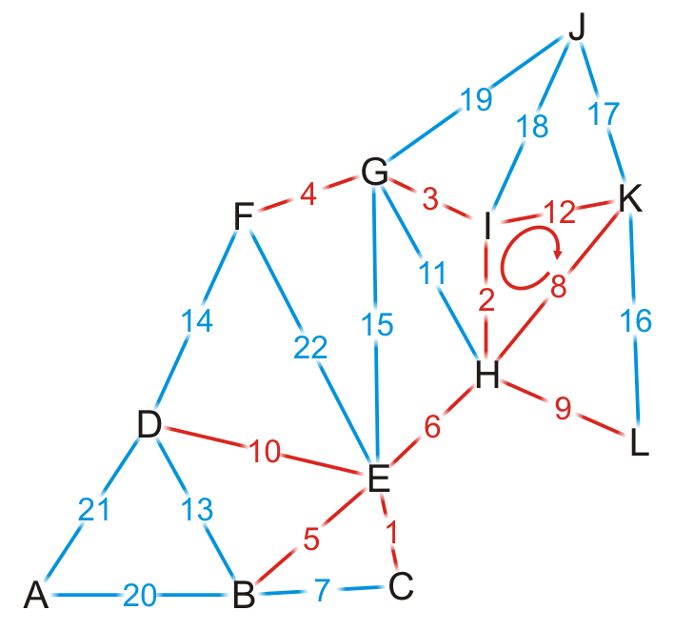
Example
{C, E}
{H, I}
{G, I}
{F, G}
{B, E}
{E, H}
{B, C}
{H, K}
{H, L}
{D, E}
{G, H}
{I, K}
{B, D}
{D, F}
{E, G}
{K, L}
{J, K}
{J, I}
{J, G}
{A, B}
{A, D}
{E, F}
We try adding {I, K}, but it creates a cycle

Slide 44
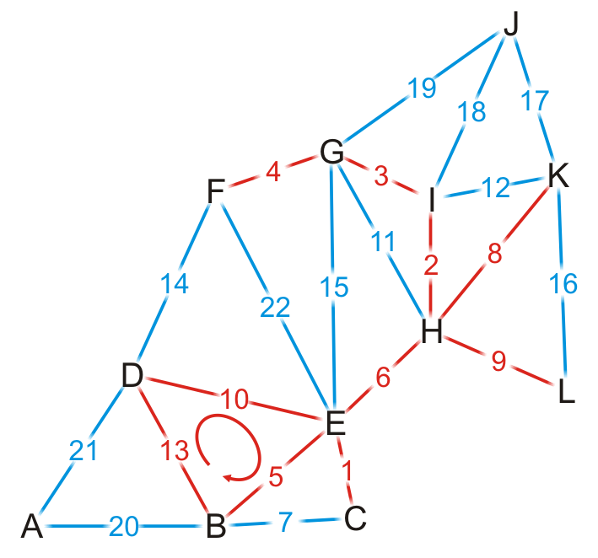
Example
{C, E}
{H, I}
{G, I}
{F, G}
{B, E}
{E, H}
{B, C}
{H, K}
{H, L}
{D, E}
{G, H}
{I, K}
{B, D}
{D, F}
{E, G}
{K, L}
{J, K}
{J, I}
{J, G}
{A, B}
{A, D}
{E, F}
We try adding {B, D}, but it creates a cycle

Slide 45
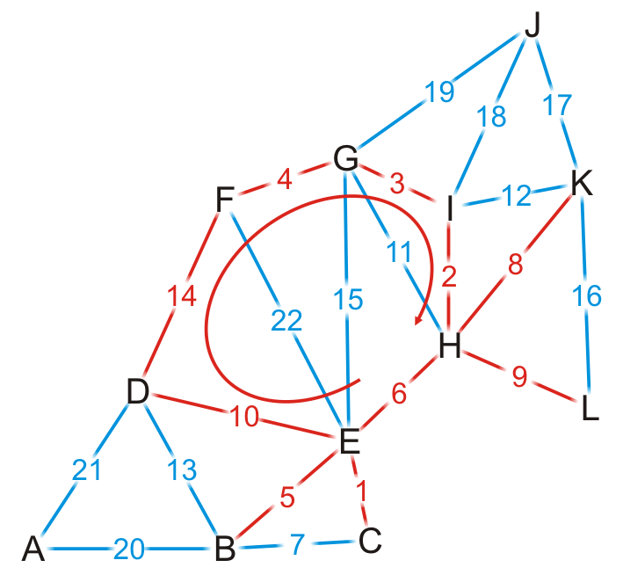
Example
{C, E}
{H, I}
{G, I}
{F, G}
{B, E}
{E, H}
{B, C}
{H, K}
{H, L}
{D, E}
{G, H}
{I, K}
{B, D}
{D, F}
{E, G}
{K, L}
{J, K}
{J, I}
{J, G}
{A, B}
{A, D}
{E, F}
We try adding {D, F}, but it creates a cycle

Slide 46
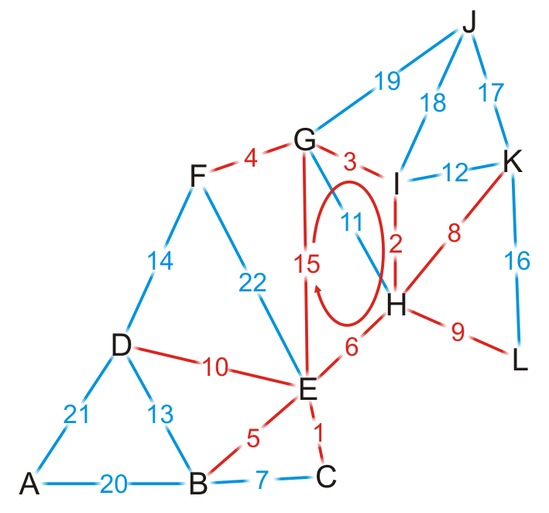
Example
{C, E}
{H, I}
{G, I}
{F, G}
{B, E}
{E, H}
{B, C}
{H, K}
{H, L}
{D, E}
{G, H}
{I, K}
{B, D}
{D, F}
{E, G}
{K, L}
{J, K}
{J, I}
{J, G}
{A, B}
{A, D}
{E, F}
We try adding {E, G}, but it creates a cycle

Slide 47
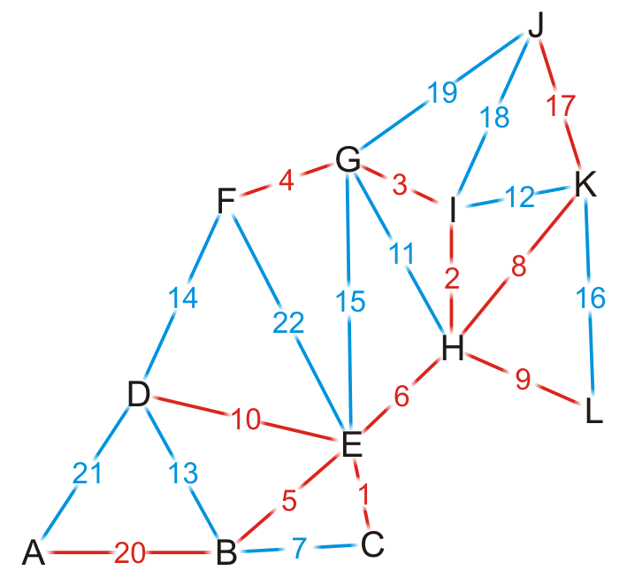
Example
{C, E}
{H, I}
{G, I}
{F, G}
{B, E}
{E, H}
{B, C}
{H, K}
{H, L}
{D, E}
{G, H}
{I, K}
{B, D}
{D, F}
{E, G}
{K, L}
{J, K}
{J, I}
{J, G}
{A, B}
{A, D}
{E, F}
By observation, we can still add edges {J, K} and {A, B}

Slide 48
Example
{C, E}
{H, I}
{G, I}
{F, G}
{B, E}
{E, H}
{B, C}
{H, K}
{H, L}
{D, E}
{G, H}
{I, K}
{B, D}
{D, F}
{E, G}
{K, L}
{J, K}
{J, I}
{J, G}
{A, B}
{A, D}
{E, F}
Having added {A, B}, we now have 11 edges
We terminate the loop
We have our minimum spanning tree

Slide 49
Analysis
Implementation
We would store the edges and their weights in an array
We would sort the edges using either quicksort or some distribution sort
To determine if a cycle is created, we could perform a traversal
A run-time of Ο(|V|)
Consequently, the run-time would be Ο(|E| ln(|E|) + |E|·|V|)
However, |E| = O(|V|²), so ln(E) = O(ln(|V|²)) = O(2 ln(|V|)) = O(ln(|V|))
Consequently, the run-time would be Ο(|E| ln(|V|) + |E||V|) = Ο(|E|·|V|)
The critical operation is determining if two vertices are connected

Slide 50
Analysis
Instead, we could use disjoint sets
Consider edges in the same connected sub-graph as forming a set
{B, C, E}, {F, G, H, I}

Slide 51
Analysis
Instead, we could use disjoint sets
Consider edges in the same connected sub-graph as forming a set
If the vertices of the next edge are in different sets, take the union of the two sets
Add edge (E, H)?
{B, C, E}, {F, G, H, I}

Slide 52
Analysis
Instead, we could use disjoint sets
Consider edges in the same connected sub-graph as forming a set
If the vertices of the next edge are in different sets, take the union of the two sets
Add edge (E, H)?
{B, C, E}, {F, G, H, I}
{B, C, E, F, G, H, I}

Slide 53
Analysis
Instead, we could use disjoint sets
Consider edges in the same connected sub-graph as forming a set
If the vertices of the next edge are in different sets, take the union of the two sets
Do not add an edge if both vertices are in the same set
Add edge (E, H)?
{B, C, E}, {F, G, H, I}
{B, C, E, F, G, H, I}

Slide 54
Analysis
The disjoint set data structure has the following average run-times:
Checking if two vertices are in the same set is Θ(α(|V|))
Taking the union of two disjoint sets is Θ(α(|V|))
For all possible sizes of |V|, α(|V|) = Θ(1)

Slide 55
Analysis
Thus, checking and building the minimum spanning tree is now Ο(|E|)
The dominant time is now the time required to sort the edges:
Using quicksort, the run-time is Ο(|E| ln(|E|)) = Ο(|E| ln(|V|))
If there is an efficient Θ(|E|) sorting algorithm, the run-time is then Θ(|E|)

Slide 56
Example
Going through the example again with disjoint sets

Slide 57
Example
{C, E}
{H, I}
{G, I}
{F, G}
{B, E}
{E, H}
{B, C}
{H, K}
{H, L}
{D, E}
{G, H}
{I, K}
{B, D}
{D, F}
{E, G}
{K, L}
{J, K}
{J, I}
{J, G}
{A, B}
{A, D}
{E, F}
We start with twelve singletons
{A}, {B}, {C}, {D}, {E}, {F}, {G}, {H}, {I}, {J}, {K}, {L}

Slide 58
Example
{C, E}
{H, I}
{G, I}
{F, G}
{B, E}
{E, H}
{B, C}
{H, K}
{H, L}
{D, E}
{G, H}
{I, K}
{B, D}
{D, F}
{E, G}
{K, L}
{J, K}
{J, I}
{J, G}
{A, B}
{A, D}
{E, F}
We start by adding edge {C, E}
{A}, {B}, {C, E}, {D}, {F}, {G}, {H}, {I}, {J}, {K}, {L}

Slide 59
Example
{C, E}
{H, I}
{G, I}
{F, G}
{B, E}
{E, H}
{B, C}
{H, K}
{H, L}
{D, E}
{G, H}
{I, K}
{B, D}
{D, F}
{E, G}
{K, L}
{J, K}
{J, I}
{J, G}
{A, B}
{A, D}
{E, F}
We add edge {H, I}
{A}, {B}, {C, E}, {D}, {F}, {G}, {H, I}, {J}, {K}, {L}

Slide 60
Example
{C, E}
{H, I}
{G, I}
{F, G}
{B, E}
{E, H}
{B, C}
{H, K}
{H, L}
{D, E}
{G, H}
{I, K}
{B, D}
{D, F}
{E, G}
{K, L}
{J, K}
{J, I}
{J, G}
{A, B}
{A, D}
{E, F}
Similarly, we add {G, I}, {F, G}, {B, E}
{A}, {B, C, E}, {D}, {F, G, H, I}, {J}, {K}, {L}

Slide 61
Example
{C, E}
{H, I}
{G, I}
{F, G}
{B, E}
{E, H}
{B, C}
{H, K}
{H, L}
{D, E}
{G, H}
{I, K}
{B, D}
{D, F}
{E, G}
{K, L}
{J, K}
{J, I}
{J, G}
{A, B}
{A, D}
{E, F}
The vertices of {E, H} are in different sets
{A}, {B, C, E}, {D}, {F, G, H, I}, {J}, {K}, {L}

Slide 62
Example
{C, E}
{H, I}
{G, I}
{F, G}
{B, E}
{E, H}
{B, C}
{H, K}
{H, L}
{D, E}
{G, H}
{I, K}
{B, D}
{D, F}
{E, G}
{K, L}
{J, K}
{J, I}
{J, G}
{A, B}
{A, D}
{E, F}
Adding edge {E, H} creates a larger union
{A}, {B, C, E, F, G, H, I}, {D}, {J}, {K}, {L}

Slide 63
Example
{C, E}
{H, I}
{G, I}
{F, G}
{B, E}
{E, H}
{B, C}
{H, K}
{H, L}
{D, E}
{G, H}
{I, K}
{B, D}
{D, F}
{E, G}
{K, L}
{J, K}
{J, I}
{J, G}
{A, B}
{A, D}
{E, F}
We try adding {B, C}, but it creates a cycle
{A}, {B, C, E, F, G, H, I}, {D}, {J}, {K}, {L}

Slide 64
Example
{C, E}
{H, I}
{G, I}
{F, G}
{B, E}
{E, H}
{B, C}
{H, K}
{H, L}
{D, E}
{G, H}
{I, K}
{B, D}
{D, F}
{E, G}
{K, L}
{J, K}
{J, I}
{J, G}
{A, B}
{A, D}
{E, F}
We add edge {H, K}, {H, L} and {D, E}
{A}, {B, C, D, E, F, G, H, I, K, L}, {J}

Slide 65
Example
{C, E}
{H, I}
{G, I}
{F, G}
{B, E}
{E, H}
{B, C}
{H, K}
{H, L}
{D, E}
{G, H}
{I, K}
{B, D}
{D, F}
{E, G}
{K, L}
{J, K}
{J, I}
{J, G}
{A, B}
{A, D}
{E, F}
Both G and H are in the same set
{A}, {B, C, D, E, F, G, H, I, K, L}, {J}

Slide 66
Example
{C, E}
{H, I}
{G, I}
{F, G}
{B, E}
{E, H}
{B, C}
{H, K}
{H, L}
{D, E}
{G, H}
{I, K}
{B, D}
{D, F}
{E, G}
{K, L}
{J, K}
{J, I}
{J, G}
{A, B}
{A, D}
{E, F}
Both {I, K} are in the same set
{A}, {B, C, D, E, F, G, H, I, K, L}, {J}

Slide 67
Example
{C, E}
{H, I}
{G, I}
{F, G}
{B, E}
{E, H}
{B, C}
{H, K}
{H, L}
{D, E}
{G, H}
{I, K}
{B, D}
{D, F}
{E, G}
{K, L}
{J, K}
{J, I}
{J, G}
{A, B}
{A, D}
{E, F}
Both {B, D} are in the same set
{A}, {B, C, D, E, F, G, H, I, K, L}, {J}

Slide 68
Example
{C, E}
{H, I}
{G, I}
{F, G}
{B, E}
{E, H}
{B, C}
{H, K}
{H, L}
{D, E}
{G, H}
{I, K}
{B, D}
{D, F}
{E, G}
{K, L}
{J, K}
{J, I}
{J, G}
{A, B}
{A, D}
{E, F}
Both {D, F} are in the same set
{A}, {B, C, D, E, F, G, H, I, K, L}, {J}

Slide 69
Example
{C, E}
{H, I}
{G, I}
{F, G}
{B, E}
{E, H}
{B, C}
{H, K}
{H, L}
{D, E}
{G, H}
{I, K}
{B, D}
{D, F}
{E, G}
{K, L}
{J, K}
{J, I}
{J, G}
{A, B}
{A, D}
{E, F}
We end when there is only one set, having added (A, B)
{A, B, C, D, E, F, G, H, I, K, L, J}

Slide 70
Summary
This topic has covered Kruskal’s algorithm
Sort the edges by weight
Create a disjoint set of the vertices
Begin adding the edges one-by-one checking to ensure no cycles are introduced
The result is a minimum spanning tree
The run time is Ο(|E| ln(|V|)

Slide 71
References
Wikipedia, http://en.wikipedia.org/wiki/Minimum_spanning_tree
Wikipedia, http://en.wikipedia.org/wiki/Kruskal’s_algorithm
These slides are provided for the ECE 250 Algorithms and Data Structures course. The material in it reflects Douglas W. Harder’s best judgment in light of the information available to him at the time of preparation. Any reliance on these course slides by any party for any other purpose are the responsibility of such parties. Douglas W. Harder accepts no responsibility for damages, if any, suffered by any party as a result of decisions made or actions based on these course slides for any other purpose than that for which it was intended.

